Slide 1
Review of Internship-
SPI Master Core Design
By-
NAME- ROHAN JOSHI
REG NO.- 21BML0131

Slide 2
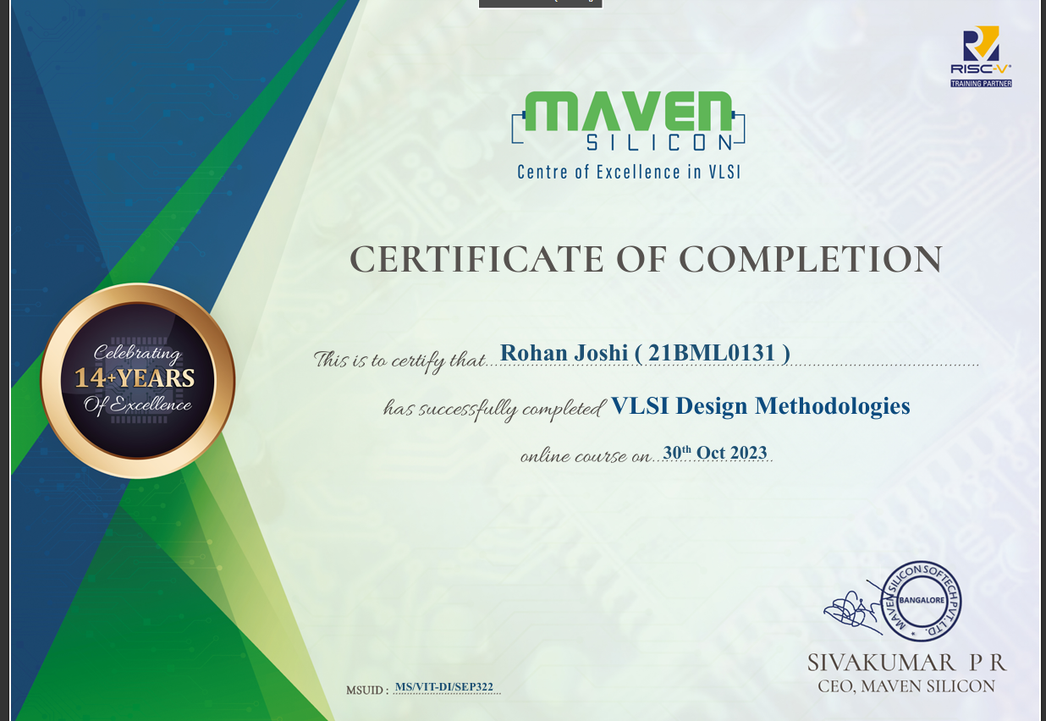

Slide 3
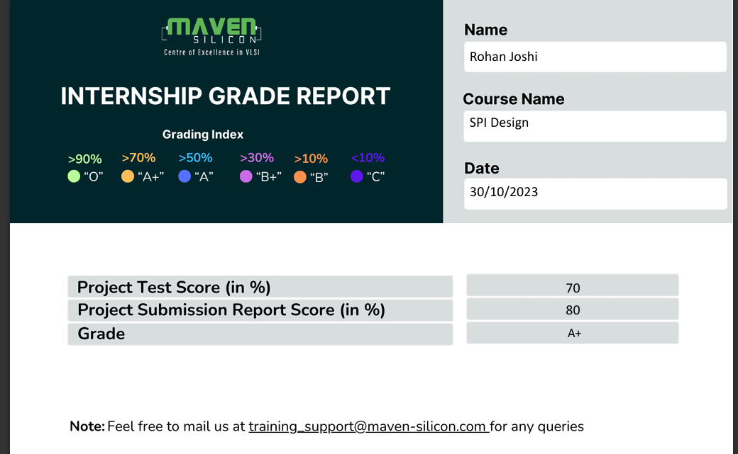

Slide 4
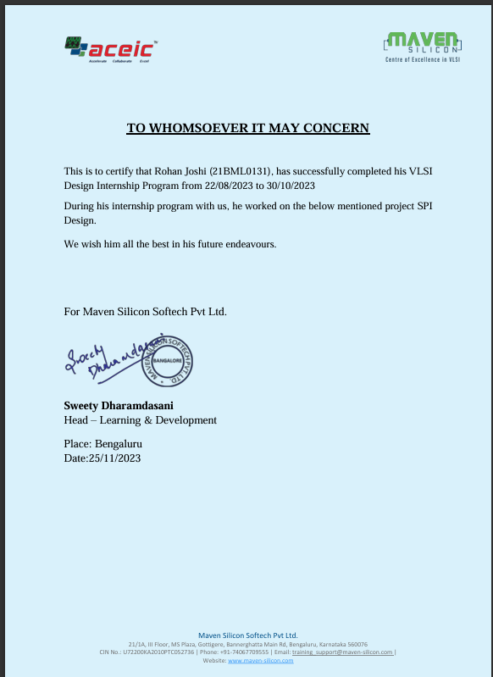

Slide 5
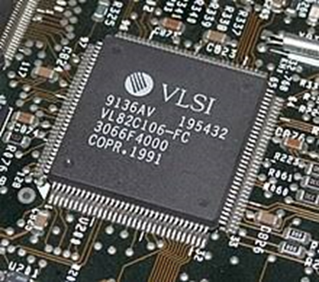
VLSI Design Methodologies
•VLSI design focuses on creating integrated circuits with millions of transistors.
•Designing at such scale requires advanced methodologies and tools.
•Designers face challenges like power consumption and area optimization.
•Modern VLSI designs use hierarchical and modular approaches.

Slide 6
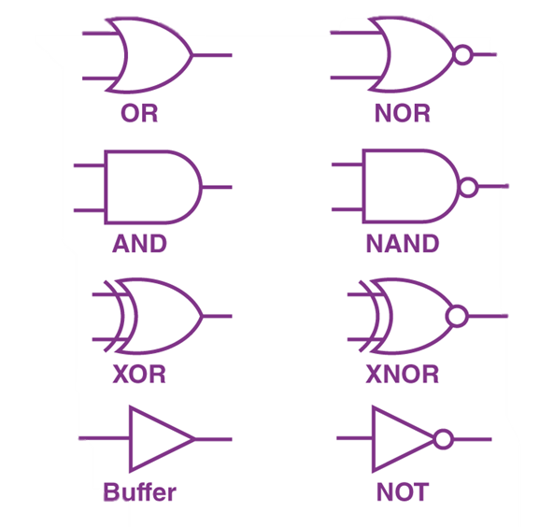
Digital Electronics and Number Systems :
•Binary Number System: Fundamental for digital representation using 0s and 1s.
• Number Systems Conversion: Essential for data manipulation and representation in binary, decimal, octal, and hexadecimal formats.
• Binary Codes: Include BCD, Gray code, and excess 3 code, serving specific purposes in digital systems.
• Logic Gates: Basic building blocks like AND, OR, NOT gates perform Boolean operations in digital logic design.
• Boolean Algebra: Governs logic operations, expression simplification, and logic minimization techniques for efficient design.

Slide 7
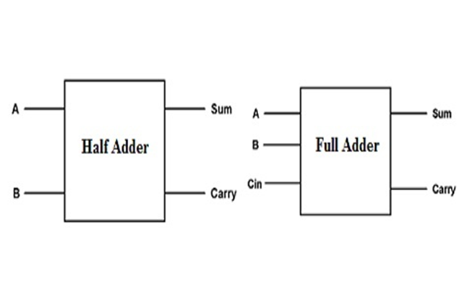
Combinational Circuits and Sequential Circuits
Combinational Circuits:
•Outputs depend only on current inputs.
•No memory or feedback.
•Designed using logic gates.
•Examples: Adders, multiplexers.
•Instantaneous output based on current inputs.

Slide 8
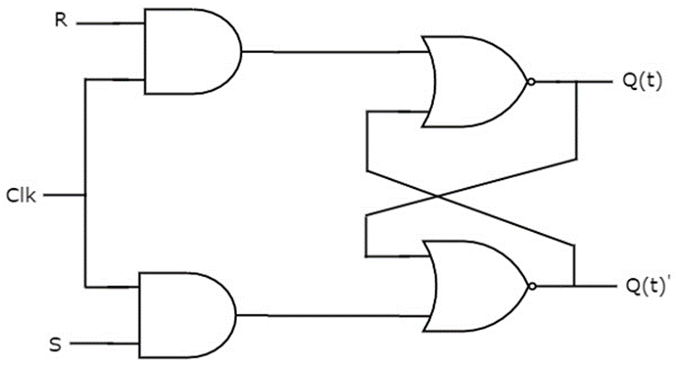
Sequential Circuits:
• Outputs depend on current inputs and past inputs (stored in memory).
• Contains memory elements (flipflops).
• Designed using combinational logic and memory elements.
• Examples: Flipflops, counters.
• Output depends on current and past inputs, includes timing considerations.

Slide 9
Introduction to VERILOG HDL
Verilog HDL is a hardware description language used to model digital systems.
It allows designers to describe the behavior of a digital circuit using constructs like procedural blocks, conditional statements, and loops.
Verilog enables designers to describe digital circuits using interconnected modules, wires, registers, and gates.
Verilog supports modular design, where complex systems are broken down into smaller, reusable modules interconnected through ports.

Slide 10
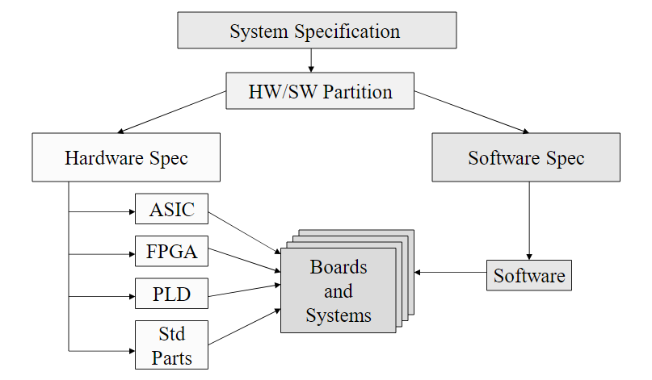
Application areas of Verilog

Slide 11
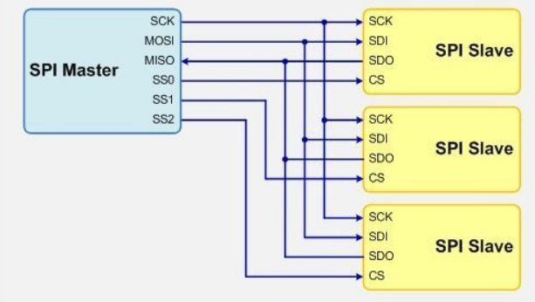
SPI Master Core Design
The project on which I have worked on presents the design and implementation of an SPI (Serial Peripheral Interface) Master Core for embedded systems.
Synchronous serial interfaces are widely used to provide economical board-level interfaces between different devices such as microcontroller, DAcs, ADCs and FPGA-based applications, enabling seamless communication with peripheral devices.
My project provides insights into the SPI protocol, the wishbone master, SPI slave and functionality of the clock generator sub-block and the shift register sub-block of the SPI Master core.

Slide 12
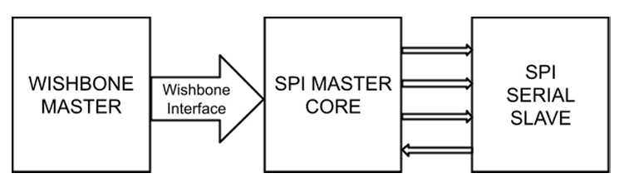
SPI Communication Architecture

Slide 13
Wishbone Master : A bus that drives the inputs.
Wishbone Interface: Allows the wishbone master to read from and write to registers within the SPI core.
SPI Master Core: It is responsible for controlling and coordinating communication with the connected slave devices.
SPI Slave: Plays a passive role in the communication, responding to commands and data requests from the SPI master.

Slide 14
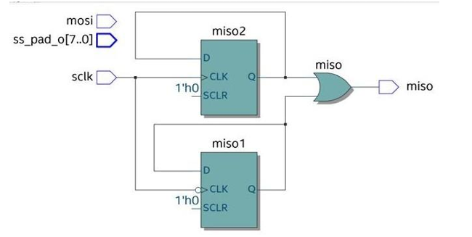
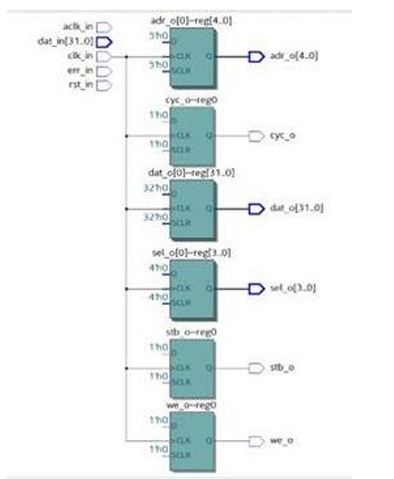
SPI Slave Block Diagram Wishbone Master Block Diagram

Slide 15
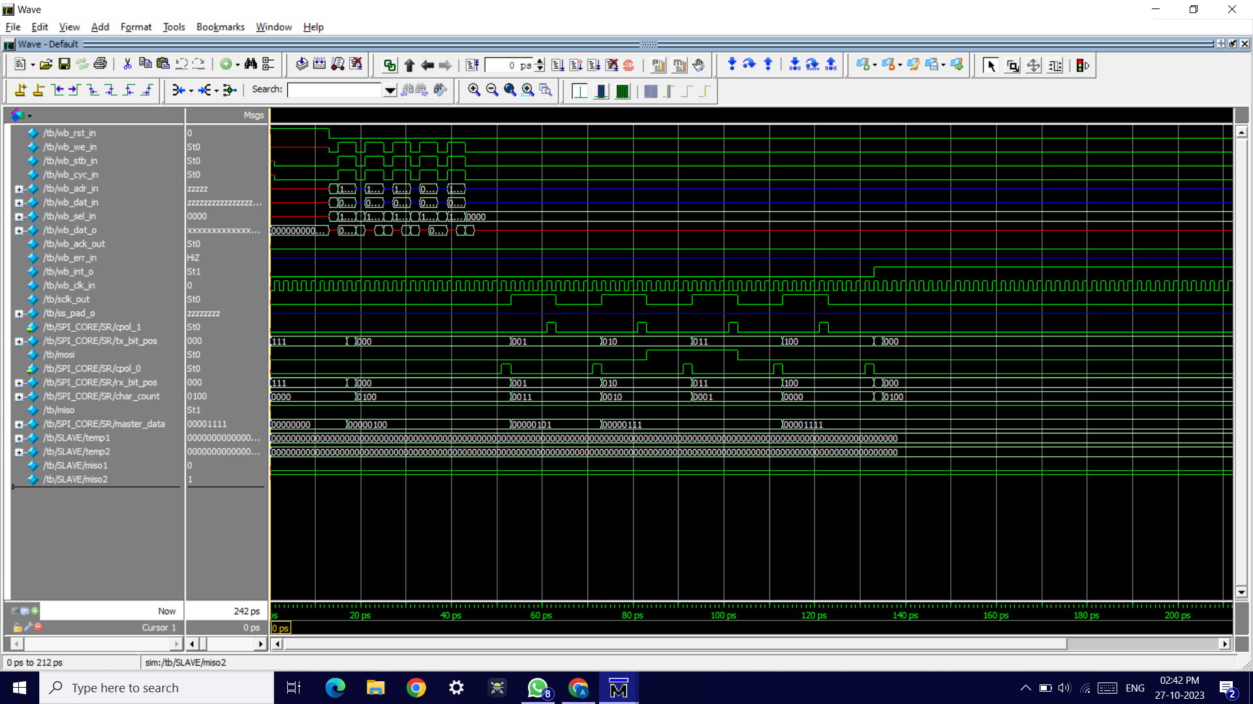
Screenshots(Top level testbench)

Slide 16
Summary
The course provided a systematic learning path that began with basic principles and progressed to more advanced topics, allowing me to create a solid foundation in VLSI design.
Hands-on projects and practical tasks let me apply academic knowledge to real-world circumstances, which improved my problem-solving abilities.
Interaction with industry professionals and mentors gave invaluable insights and direction, allowing me to better understand industry trends and best practices.
Working on industry-relevant projects and case studies helped me improve my understanding of the practical aspects of VLSI design.
The course also emphasised soft skills like communication, teamwork, and time management, which are required for a successful career in VLSI design.

Slide 17
WEEK WISE MODULE DESCRIPTION
WEEK 1:
Digital Electronics and Number Systems :
Binary Number System: Fundamental for digital representation using 0s and 1s.
Number Systems Conversion: Essential for data manipulation and representation in binary, decimal, octal, and hexadecimal formats.
Binary Codes: Include BCD, Gray code, and excess 3 code, serving specific purposes in digital systems.
Logic Gates: Basic building blocks like AND, OR, NOT gates perform Boolean operations in digital logic design.
Boolean Algebra: Governs logic operations, expression simplification, and logic minimization techniques for efficient design.
WEEK 5 / WEEK 6:
DESIGN OF SPI PROTOCOL USING MODELSIM

Slide 18
Combinational Circuits
Outputs depend only on current inputs.
No memory or feedback.
Designed using logic gates.
Instantaneous output based on current inputs.
Design of Combinational circuits
Delays in Combinational circuits
WEEK 2:
Sequential Circuits:
• Outputs depend on current inputs and past inputs (stored in memory).
• Contains memory elements (flipflops).
• Designed using combinational logic and memory elements.
• Output depends on current and past inputs, includes timing considerations.
LATCHES
FLIPFLOPS

Slide 19
WEEK 3:
FINITE STATE MACHINE
A Finite State Machine (FSM) is a mathematical model used to represent a system that can be in one of a finite number of states at any given time.
FSMs consist of a set of states, a set of transitions between these states, and a set of inputs that trigger these transitions.
FSMs are widely used in digital circuit design, control systems, and software engineering to model complex behaviors and sequential logic.
WEEK 4:
VERILOG CODING:
FULL ADDER
HALF ADDER
MULTIPLEXER
DECODER

Slide 20
WEEK 5 / WEEK 6:
DESIGN OF SPI PROTOCOL USING MODELSIM

Slide 21

THANK YOU !!!

